Slide 1
Applications of force

Slide 2
Integrals

Slide 3
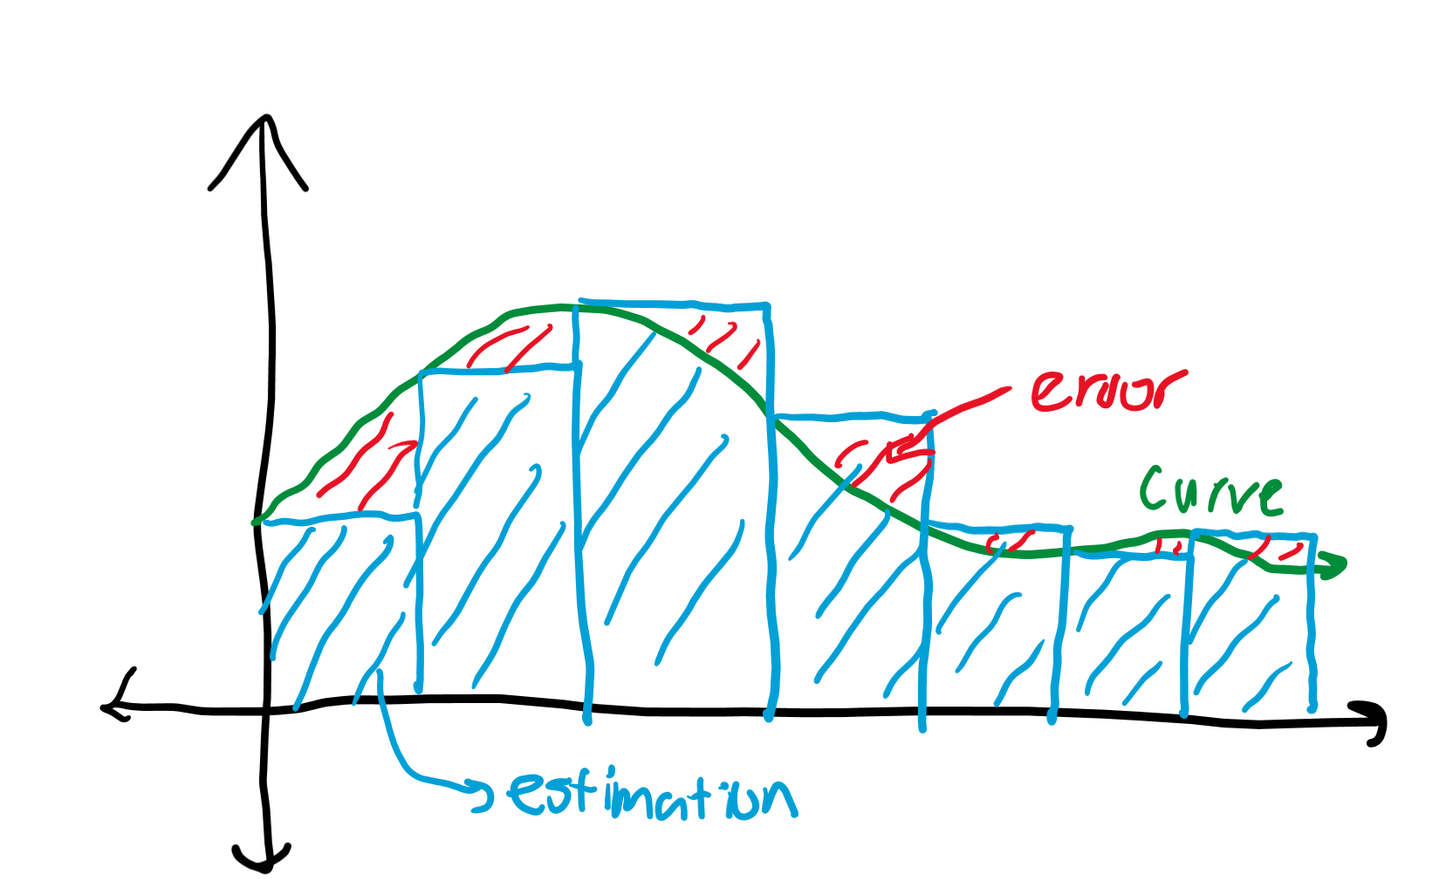
Estimating area
The area of rectangles is easy to find: base times height.
You can estimate the area under a curve by fitting little rectangles under them, and summing the area of the rectangles.
The question is determining where to put the rectangles to estimate the area of the curves.

Slide 4
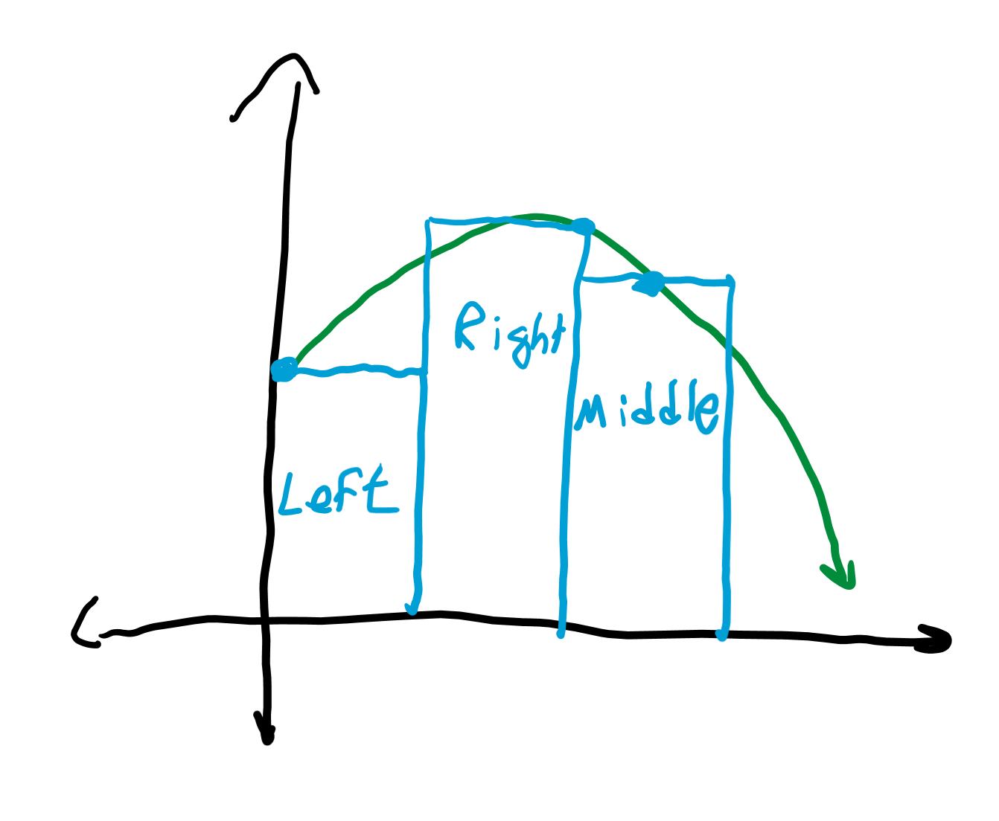
Left, right, middle approximations
Let’s fit rectangles of equal widths under the curve.
You can put the left or right corners of the rectangles on the curve.
Sometimes you can put it in the middle, but these methods are all bad if you do not use enough rectangles.

Slide 5
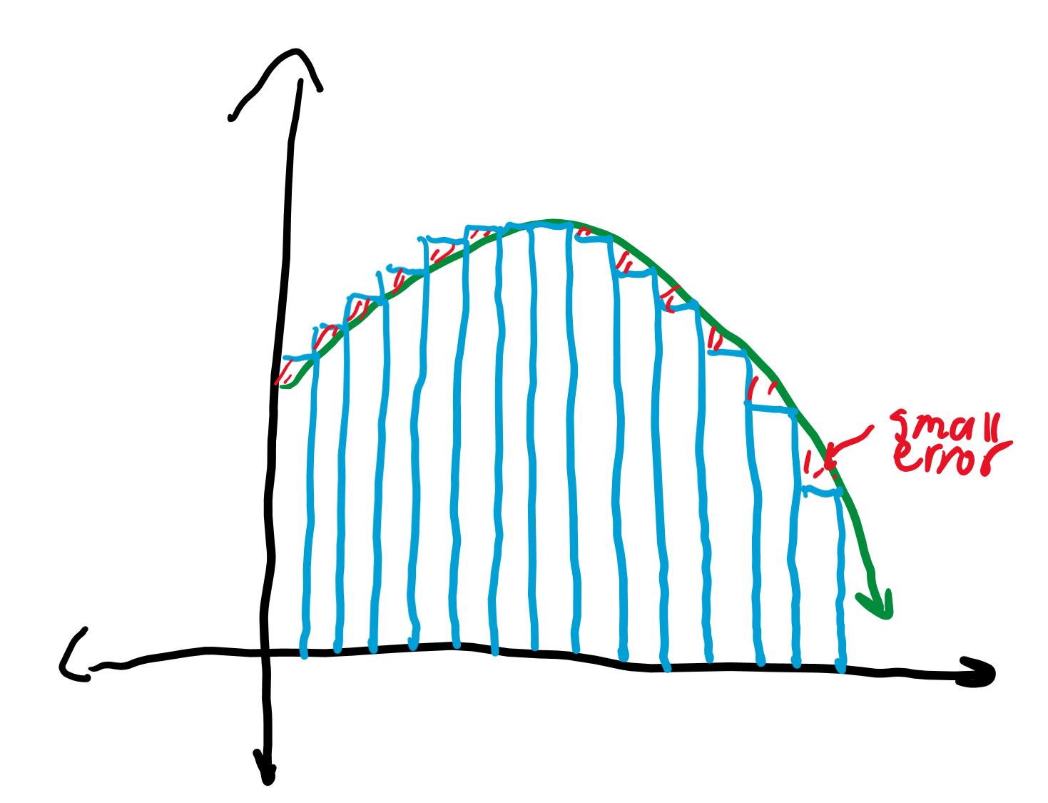
Riemann sums
As you increase the number of rectangles fit under the curve to infinity, the sum of the area of these rectangles becomes much better.
Estimations with rectangles like we did is called a Riemann sum. As we Riemann sum toward infinite rectangles, we get closer to the true area under the curve.

Slide 6
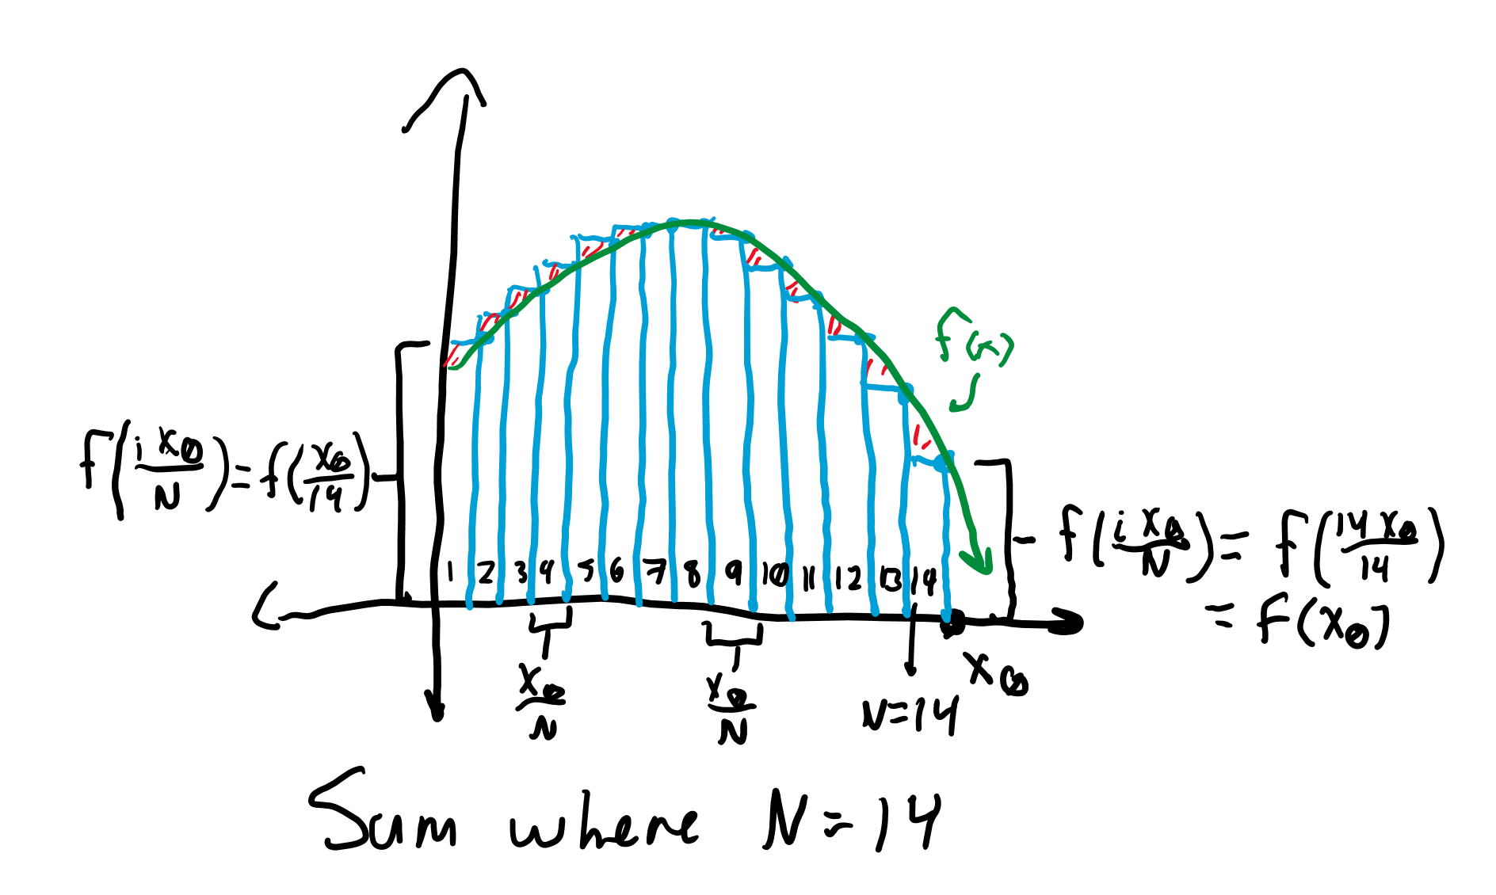
Estimating the area
Let us try to estimate the area under the curve from 0 to x₀ for some x₀ using N rectangles approximated to the right.
The width of each rectangle is x₀/N. For the i-th rectangle, the x coordinate of the right corner is x₀ * (i/N) or ix₀/N. The y coordinate, and thus height of the rectangle is f(ix₀/N).

Slide 7
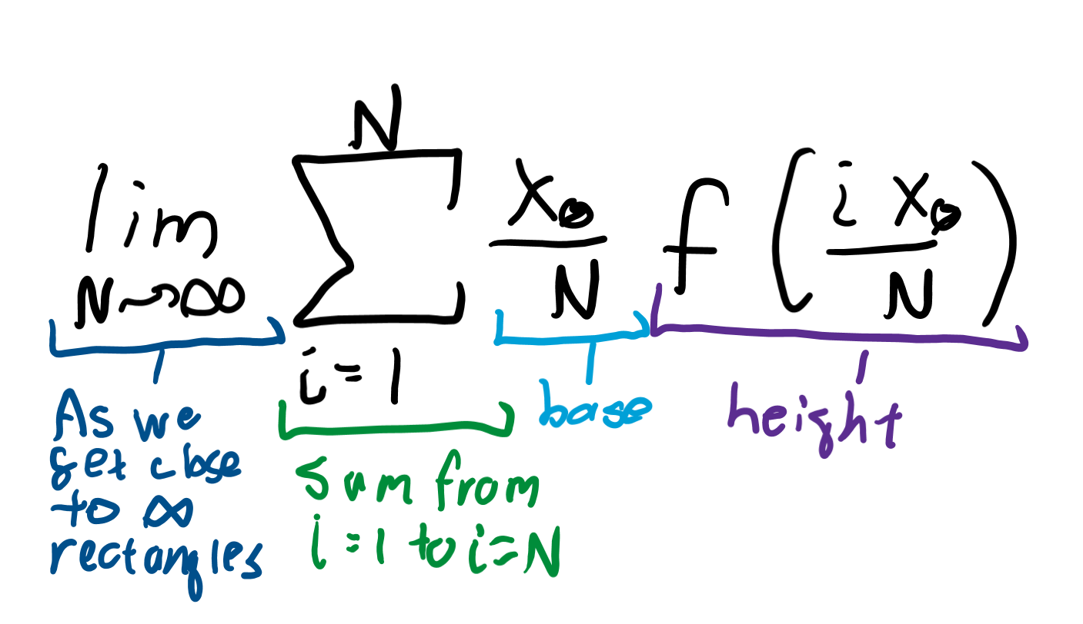
Finding the area
Thus, we want to sum the base times height of each rectangle, which would look like summing x₀/N * f(ix₀/N) from i = 0 to i = N.
Then to actually find the area under the curve, we see what the sum approaches as N, the number of rectangles, approaches infinity.

Slide 8
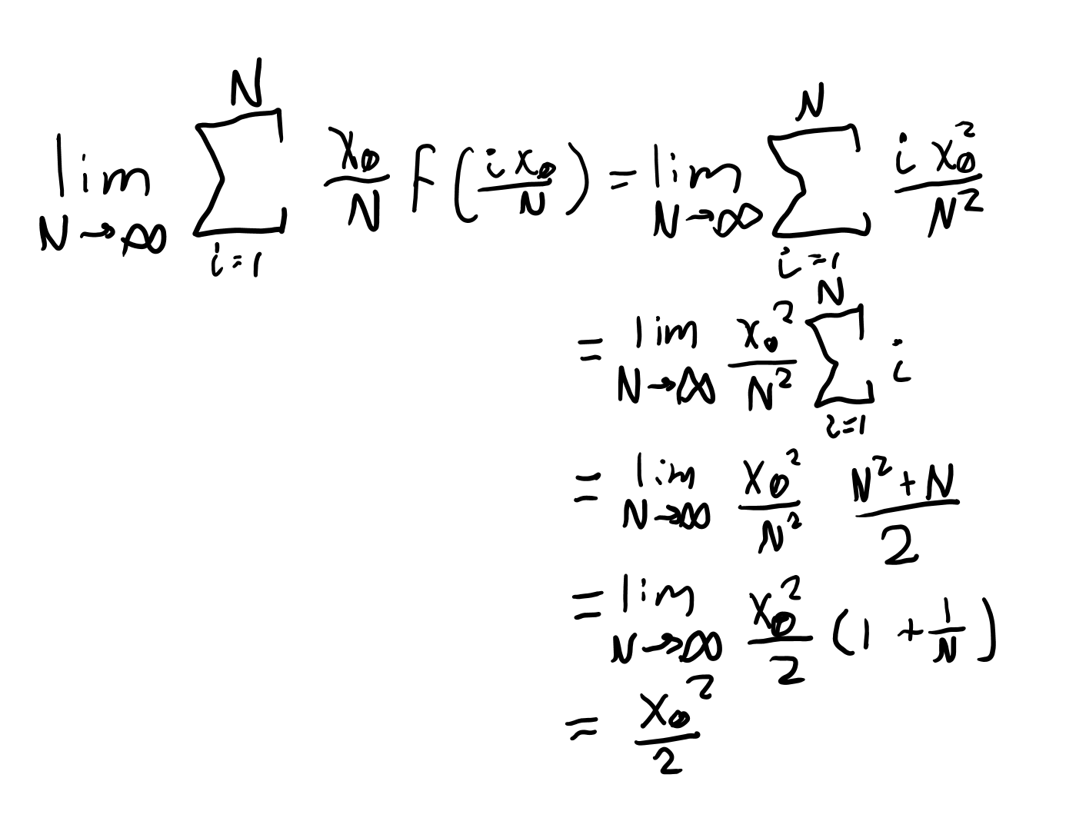
Example integral
Let’s find the area under f(x)=x from 0 to x₀.
Plugging in the formula gives the sum from i = 1 to i = N of x₀/N * f(x₀i/N) = i * x₀²/N².
The equation for the sum from i = 1 to i = N is N(N+1)/2 = (N^2+N)/2, giving us the result (N^2+N)x₀²/(2N²) = ½ x₀²(1 + 1/N). As N approaches infinity, 1/N approaches 0, giving ½ x₀²(1 + 0) = ½ x₀² as the integral.

Slide 9
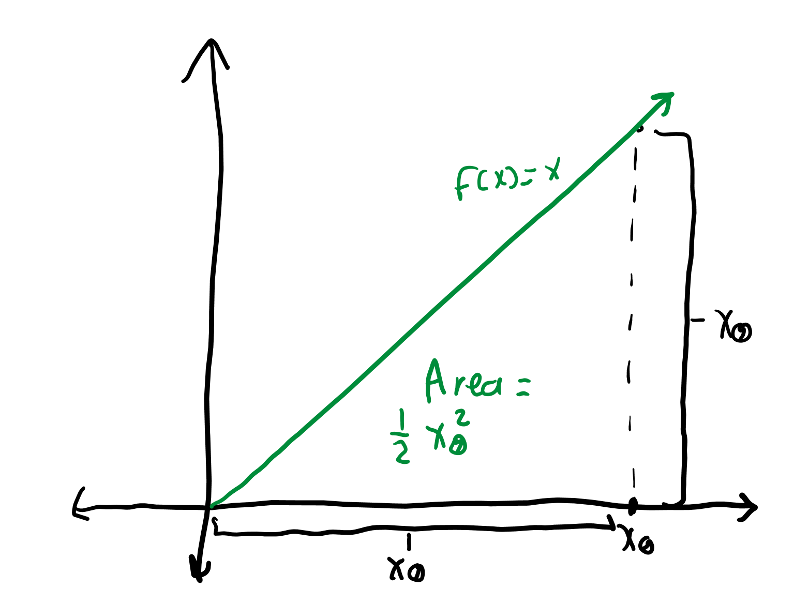
Verifying the result
We can verify our integral ½ x² for f(x) = x is correct in two ways.
For a section of the curve with base x, the height is f(x) = x, so the area of the triangle is ½ x².
We can also take the antiderivative of x to get x²/2.

Slide 10
Defining an integral
If we want to write an expression for the area under the curve f(x) = x, we would simply integrate ∫f(x)dx, where the dx simply represents that we are integrating with variable x. If we were dealing with time, we would write ∫f(t)dt.
This ∫f(x)dx thing just tells us to take the antiderivative as the integral and antiderivative are the same concept.

Slide 11
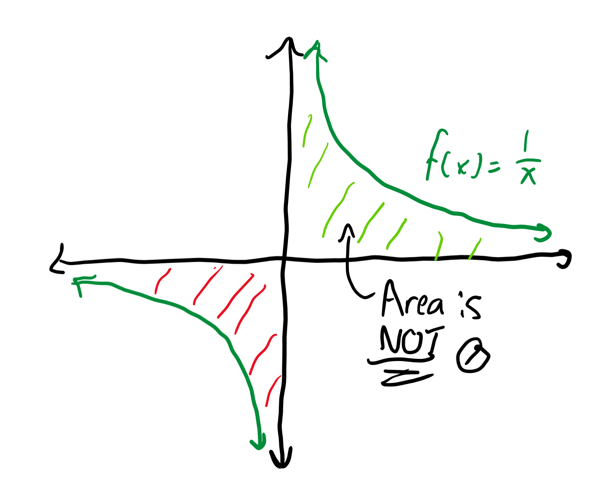
A new integral
We know the power rule for derivatives reduces the power of the polynomial by 1, but for Cx⁰, the derivative is 0 rather than sometime times x⁻¹.
Thus, the antiderivative of x⁻¹ isn’t just x⁰/0, as that would be ill-defined.
Instead, ∫x⁻¹dx = ln|x| + C.

Slide 12
Chain rule

Slide 13
Derivative of the function of a function
d/dx f(g(x)) = f’(g(x))g’(x). For example, if g(x) = x - 1, and f(x) = x^2, f(g(x)) = x^2 - 2x + 1, which has derivative 2x - 2. Or, we know f’(x) = 2x and g’(x) = 1, so we know that the derivative d/dx f(g(x)) = f’(g(x)) * g’(x), which is 2(x - 1) * 1 = 2x - 2 as well.
Sometimes when we integrate we think about the chain rule as well, which is called u-substitution.

Slide 14
U-substitution
Let’s say we want to integrate ∫1/(a - bx) dx. Let’s let u = a - bx, so du = -bdx, or in other words dx = du/-b. That means ∫1/(a - bx) dx = ∫1/u * du/-b = -1/b * ∫1/u du. We can factor the -1/b out of the integral as it’s a constant times our function, which does not get changed when we integrate.
Integrating this would give -1/b (ln|u|+ C) = -1/b (ln|a - bx| + C), so bam, we’ve taken an integral of a function that would be hard to integrate without this trick.

Slide 15
Projectile motion

Slide 16
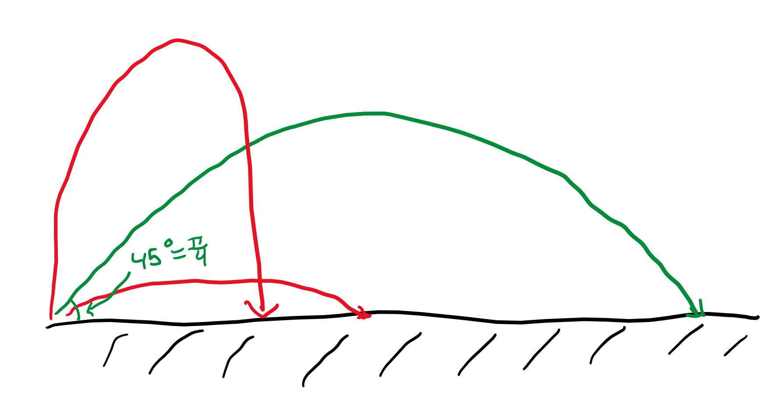
What angle is the best?
How do we know which angle is the best to launch a projectile at?
Theoretically this should be pi/4 radians, but let’s try to prove why this angle launches an object the furthest.

Slide 17
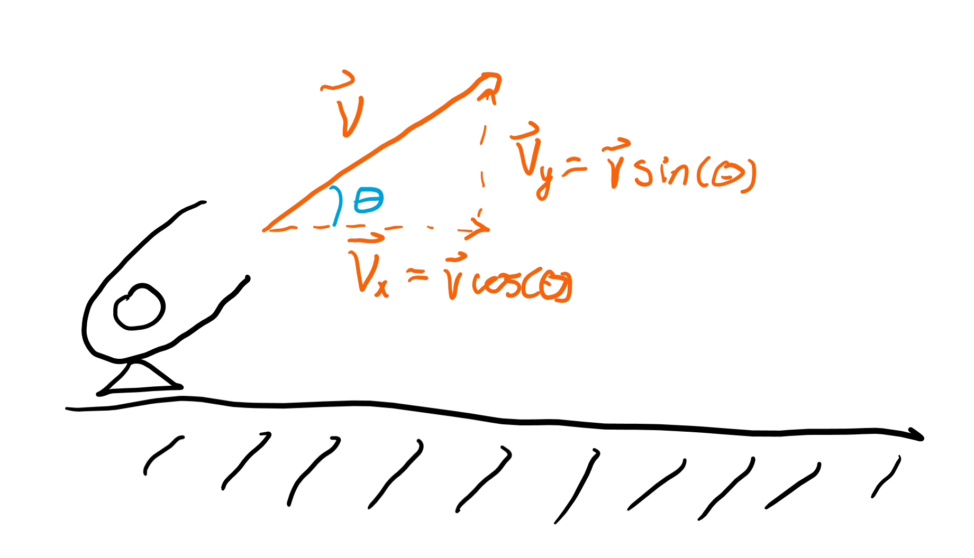
Finding vertical velocity
The vertical velocity can be found by multiplying the sine of the angle of launch to the overall velocity.
Similarly, the horizontal velocity can be found by found by multiplying the overall velocity by cosine of the angle of launch.

Slide 18
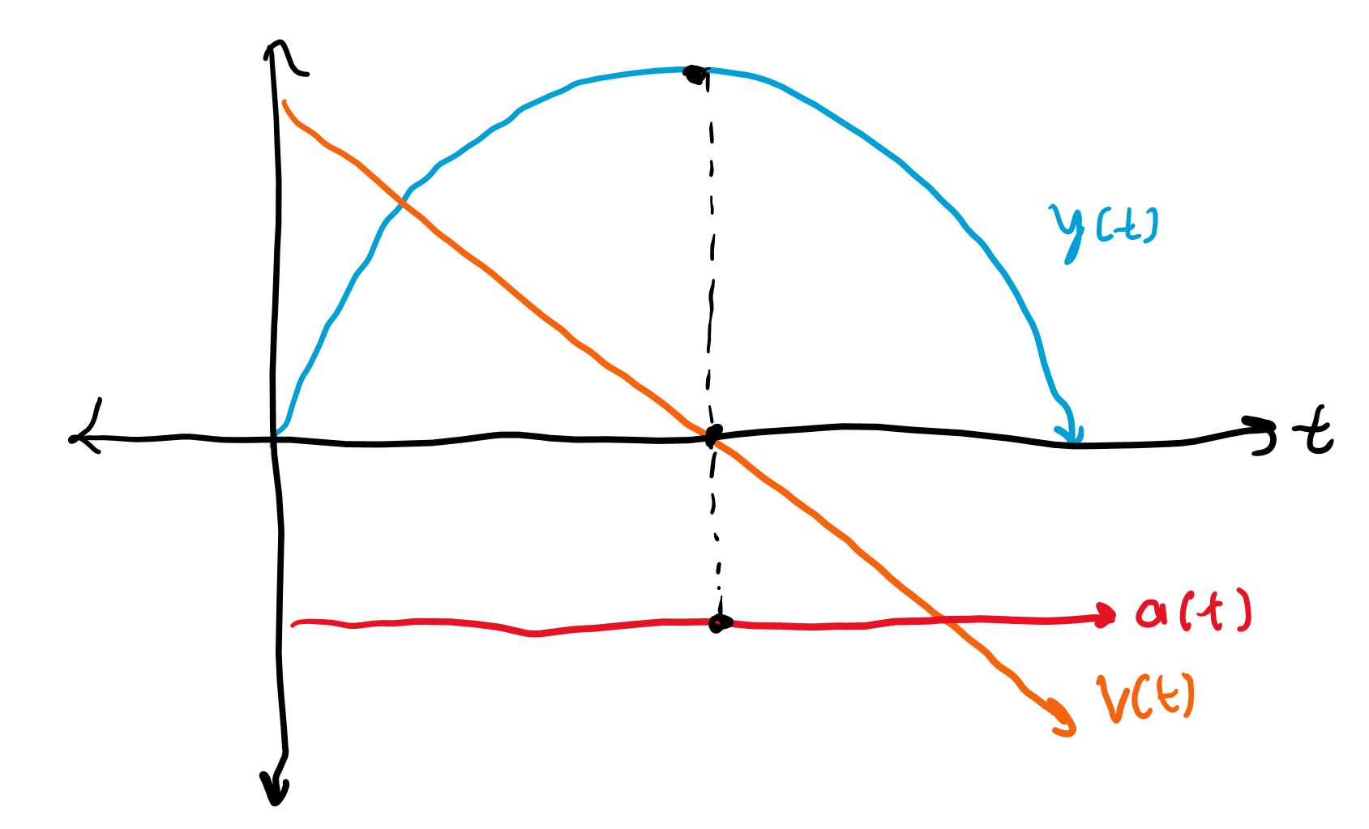
Vertical motion graphs
We can draw the height vs time, vertical velocity vs time, and acceleration vs time graphs.
Notice how the path is parabolic and it takes the same time for the object to reach the peak as it takes to fall back down from the peak.

Slide 19
Calculating time spent in air
We can calculate the time it takes for the object to reach its peak as it’s the same as calculating the amount of time it takes for the object’s vertical velocity to reach zero.
In other words, we can use the kinematic equation Δv = v_{f} - v₀ = 0 - v₀ = -v₀ = at to get t_{peak} = v_{y} / a. However, the total time traveled is twice t_{peak} as the object has to fall back down. Thus, t = 2v_{y}/g. Here g = +9.801 m/s².

Slide 20
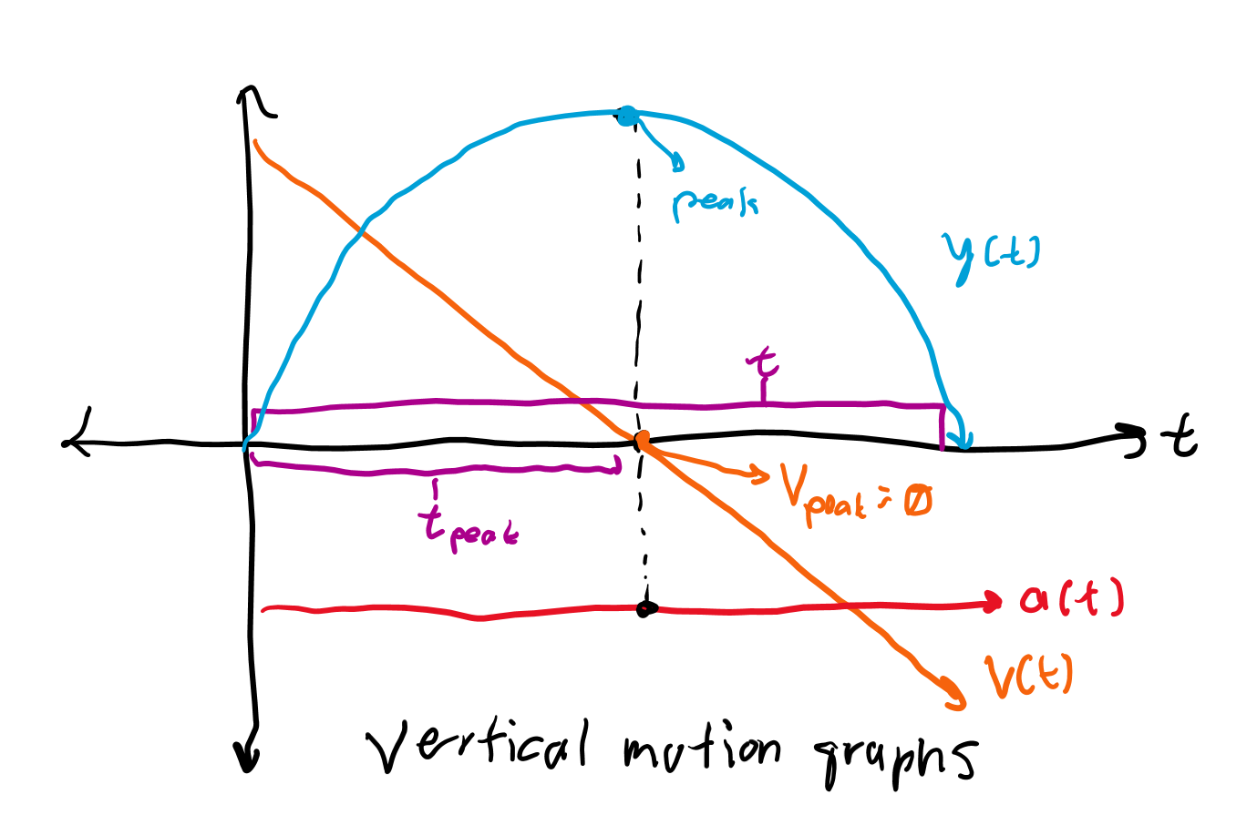
Calculating maximum height
We can use kinematic equations again to find the maximum height.
We know in half the total time travelling, the object was falling from its peak (vertical velocity = 0) to the ground. Thus, Δy = v₀t - 4.9 m/s² t² = 4.9 m/s² t², and we know how to find t from before. Thus, we can find the maximum height.

Slide 21
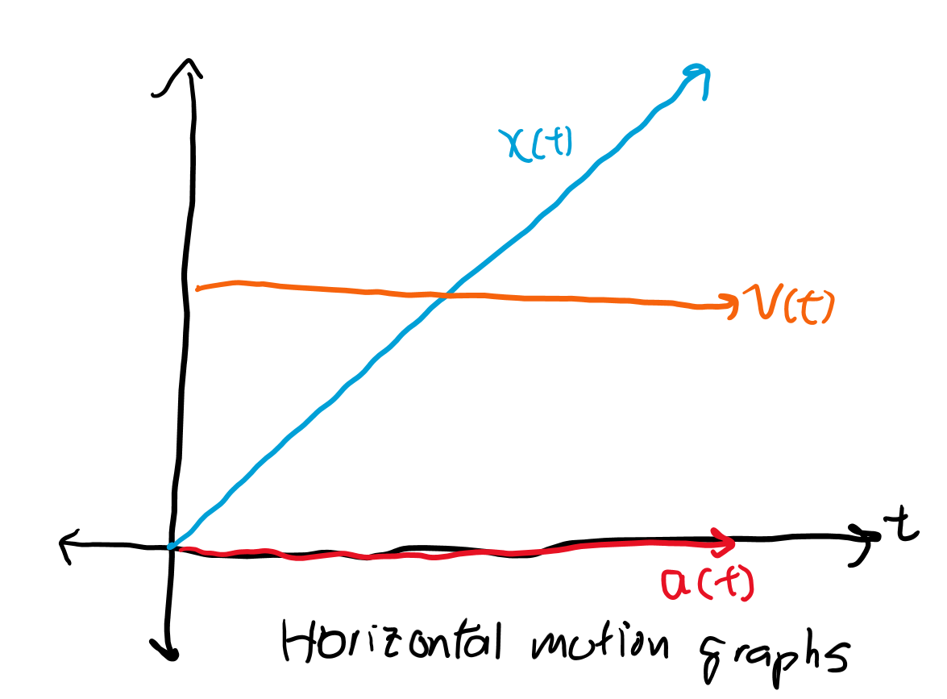
Calculate range traveled
This one is much easier. We can find the horizontal velocity by taking v * cos(θ) where θ is the angle of launch.
We simply multiply this horizontal velocity by time to find distance traveled horizontally.

Slide 22
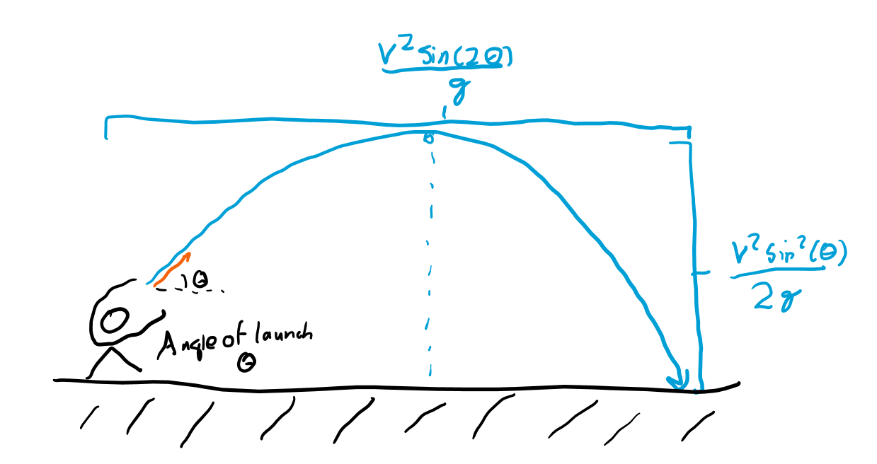
General equations
We know t_{peak} = v_{y}/g = vsin(θ)/g. We thus know Δy = ½ at² = v²sin²(θ)/(2g).
We know t = 2vsin(θ)/a, and v_{x} = vcos(θ), so Δx = v_{x}t = 2v²sin(θ)cos(θ)/(g) = v²sin(2θ)/g.

Slide 23
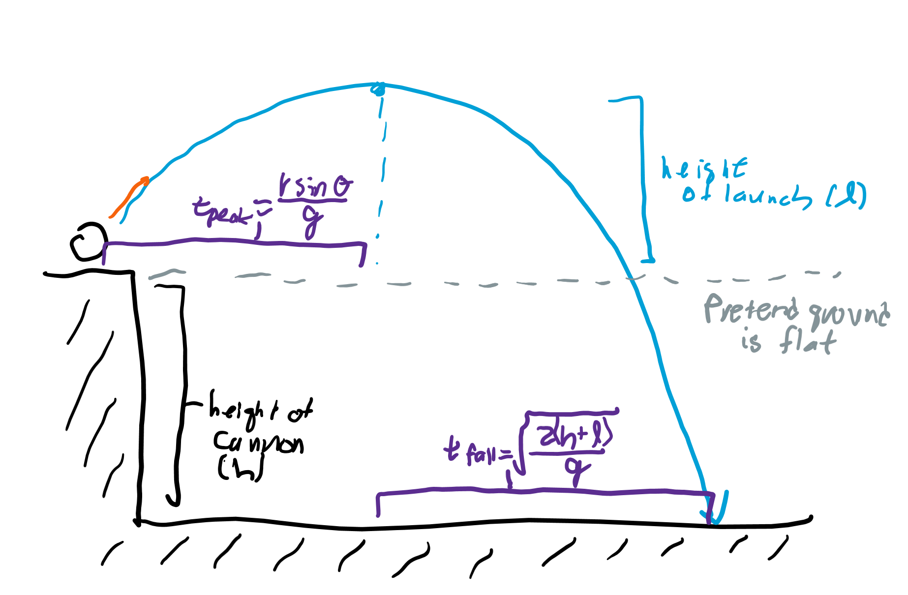
Projectile motion from a height
We first find the maximum height like before, pretending that the ground is flat.
Then, we add the maximum height of launch to the height of the cannon, which we’ll call y.
We can find the time it takes to fall from this height y using y = ½ gt².
Range is horizontal velocity multiplied by time.

Slide 24
Air resistance

Slide 25
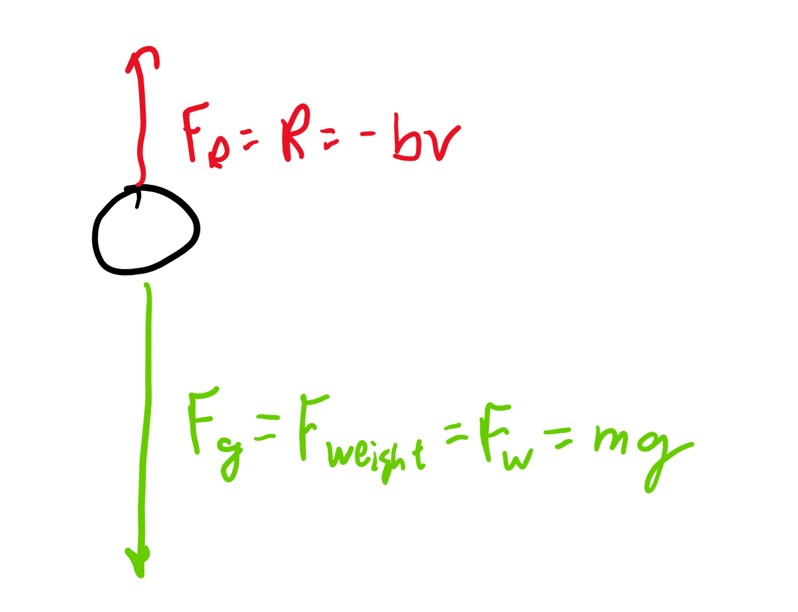
Object in free fall with air resistance
An object falling down has the force of gravity, F_{g} = mg (where g = +9.801 m/s²), acting downward upon it, but also air pushing up on it with resistive force R. Note we consider down to be POSITIVE here.
The net force F_{Net} on the object is calculated with F_{Net} = F_{g} + R = mg - bv.
For small objects, we can (linearly) approximate R as R = -bv, where b is a constant and v is the vertical velocity of the object.

Slide 26
Differential equation for net force
F_{Net} = ma = m(dv/dt) = mg - bv.
mdv = (mg - bv)dt, so m/(mg - bv)dv = dt.
Integrate both sides ∫m/(mg - bv)dv = ∫dt to get -m/b ln(mg - bv) + C₀ = t + C₁. Note that we can get rid of the absolute values because mg > bv always or we would have air resistance accelerating an object upward. We can also combine the two constants of integration into a single one by calling this -m/b ln(mg - bv) = t + C.

Slide 27
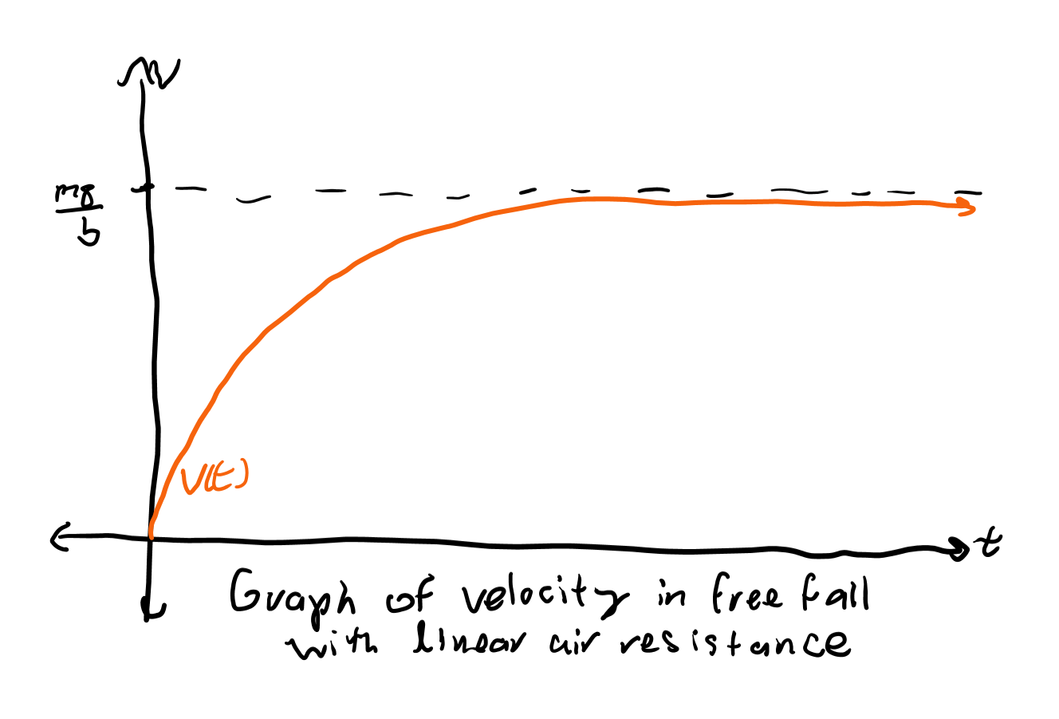
Solving the differential equation
We know when t = 0, v = 0 as the object would just be dropped at t = 0, and thus not have accelerated. Thus, -m/b ln(mg) = C.
Simplifying -m/b ln(mg - bv) = t + C = t - m/b ln(mg) gives ln(mg - bv) = -bt/m + ln(mg), and we can thus write mg - bv = e^{-bt/m}mg. Thus, bv = mg(1 - e^{-bt/m}), so v = mg/b(1-e^{-bt/m}).

Slide 28
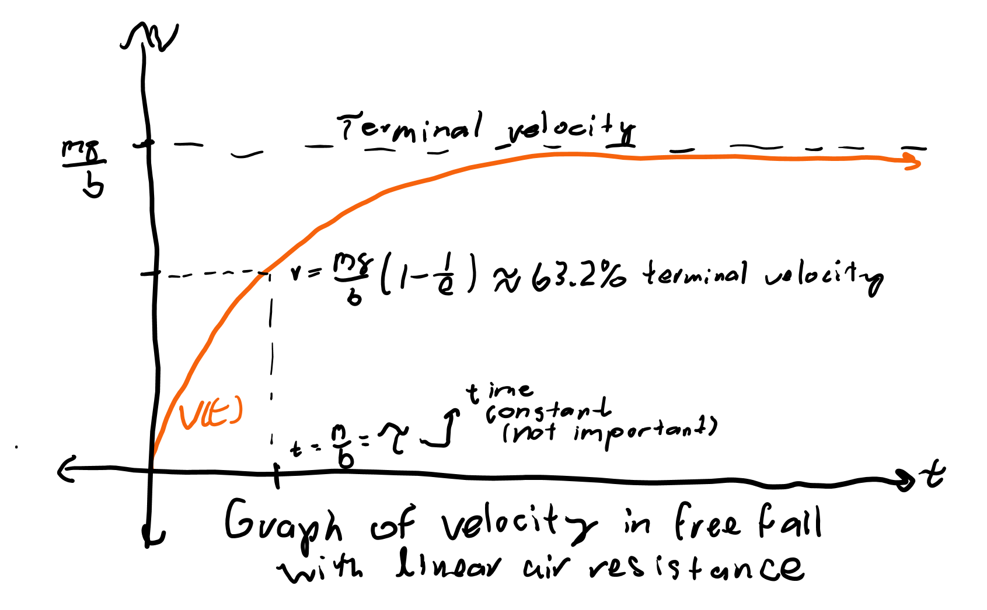
Terminal velocity
After a long enough time, R will be approximately equal to F_{g}, so the net force is 0. This also means there is no net acceleration, and velocity will stay the same.
As t gets very large, v = mg/b(1-e^{-bt/m}) turns into v = mg/b(1 - 0) = mg/b, which is our terminal velocity, the fastest the object can be falling with air resistance.

Slide 29
Newton’s laws

Slide 30
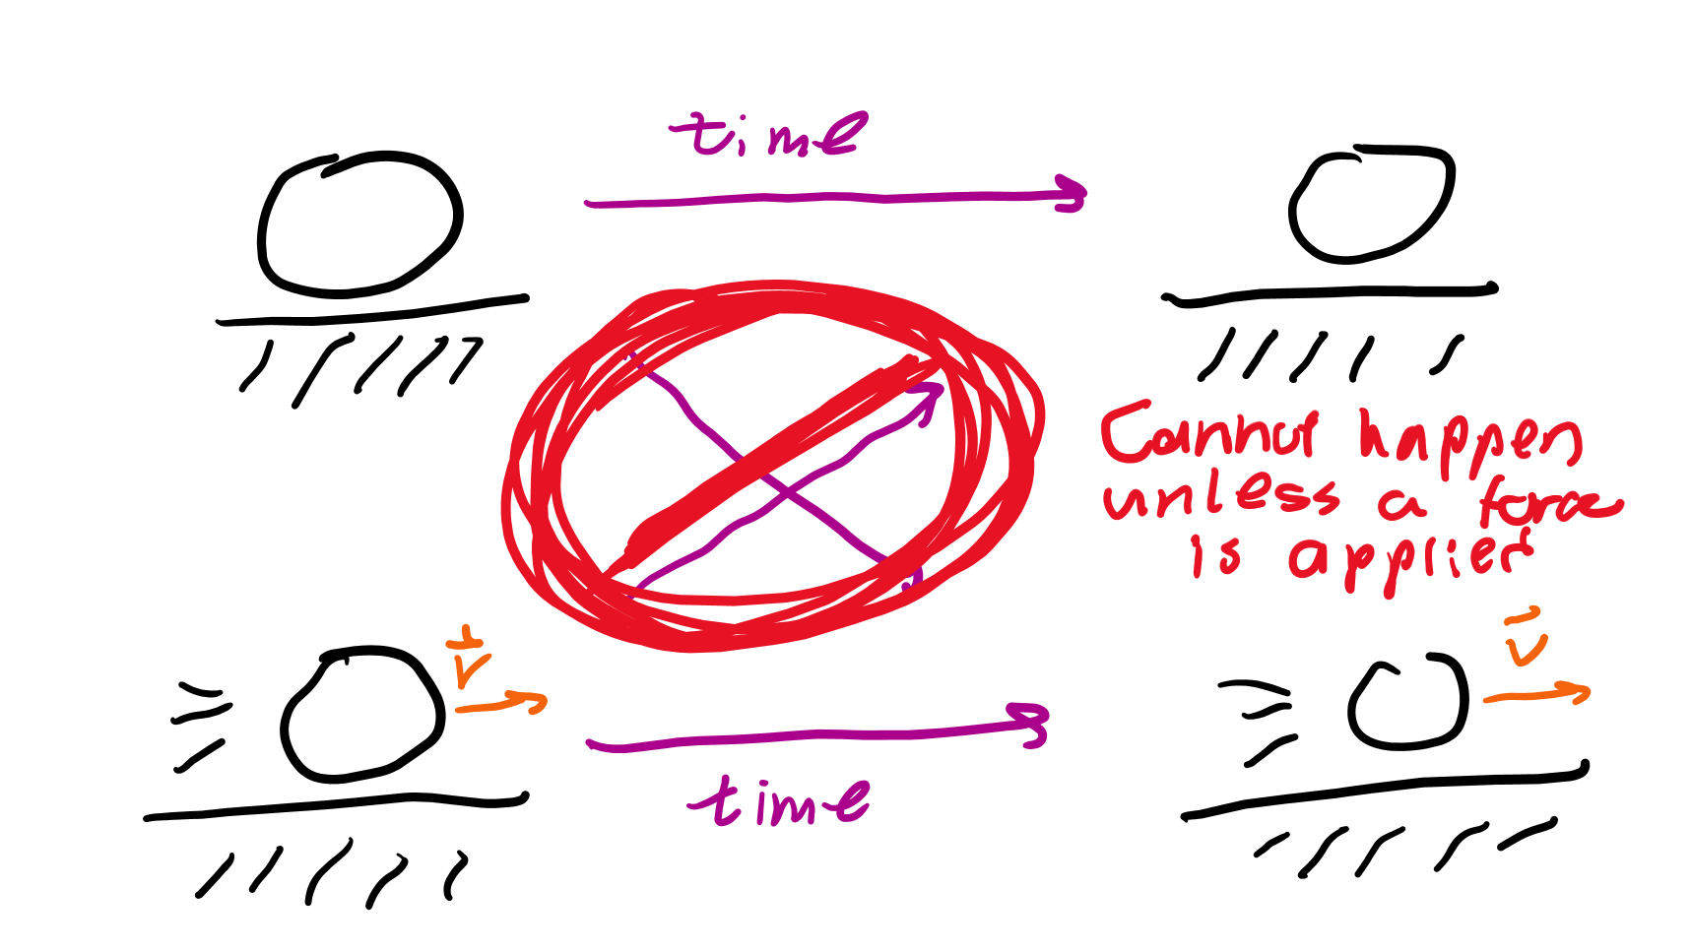
Newton’s first law
An object in motion wishes to stay in motion, and an object at rest wishes to stay at rest unless acted upon by an outside force.
The tendency to resist a change in motion is called inertia and depends on the mass.
In other words, the higher the mass, the harder it is for a force to change an object’s acceleration.

Slide 31
Newton’s second law
F = ma, but you knew this one already. :)

Slide 32
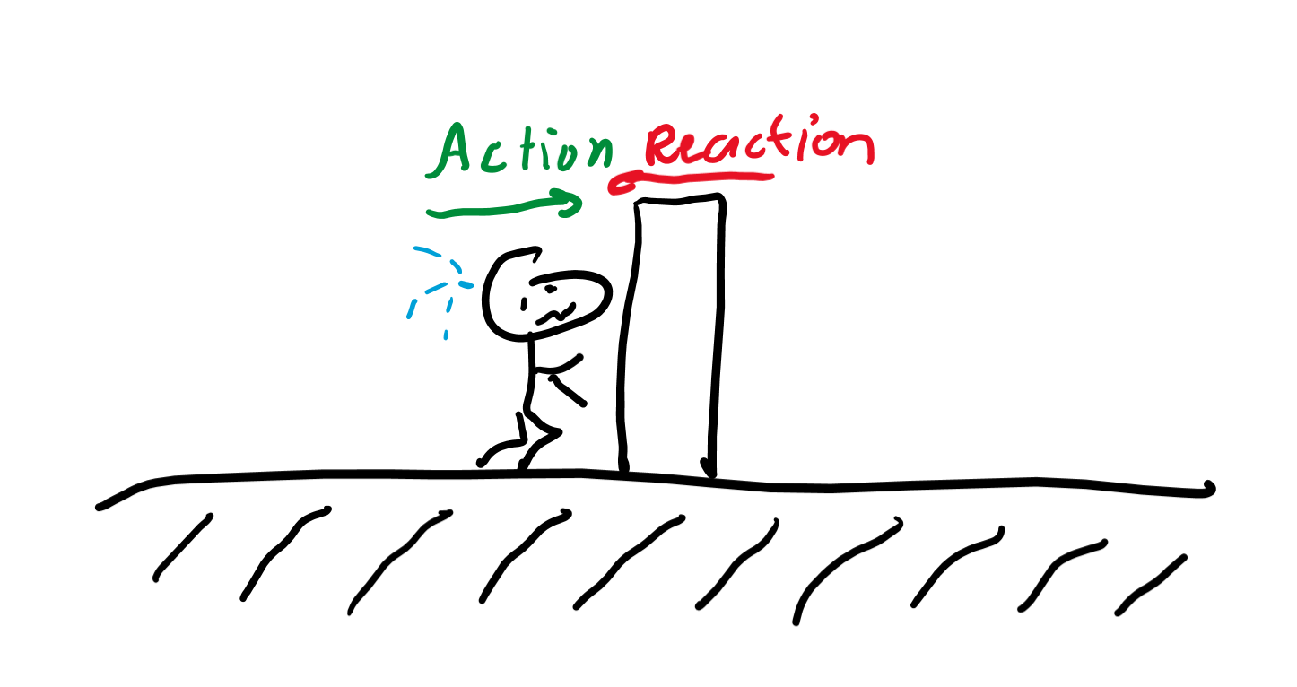
Newton’s third law
For every action, there is an equal and opposite reaction.
Thus, if object A applies force F on object B. Object B applies force F back on object A in the opposite direction.

Slide 33
Free body diagrams

Slide 34
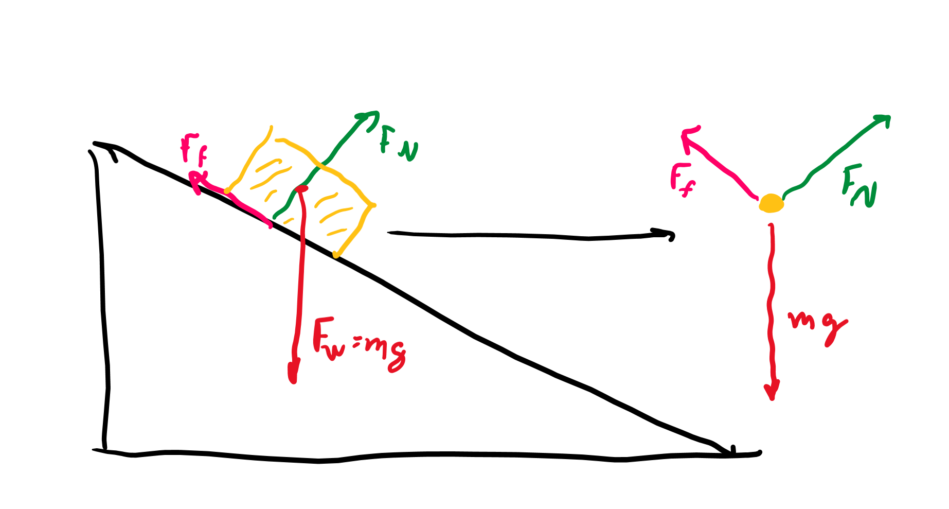
Forces on objects
For any object experiencing a series of forces, we can pretend all of them act on its center of mass.
Thus, we can draw the object as a single dot with arrows representing the forces on it.

Slide 35
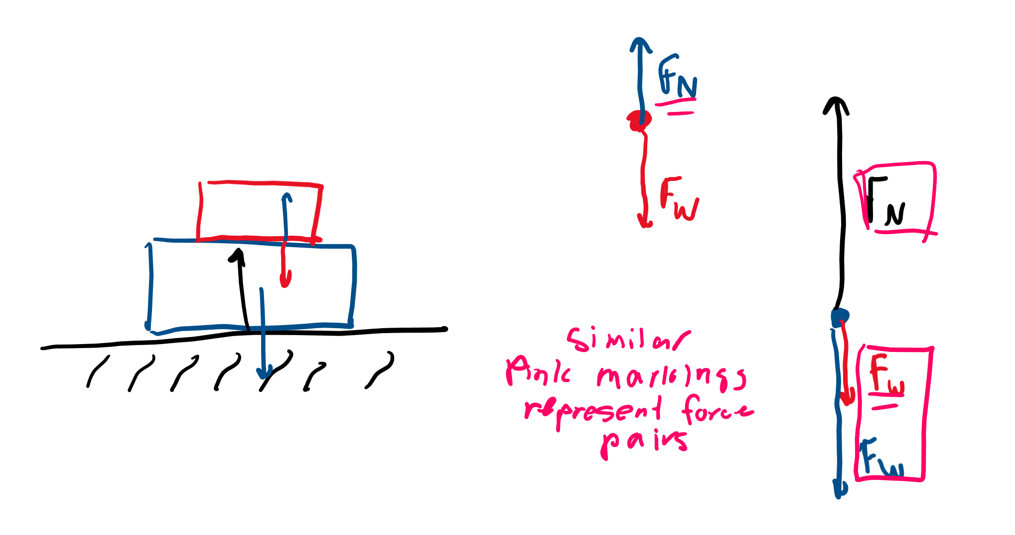
Applying Newton’s third
If we have two objects, and one applies a force on the other. The other must also apply the same force back on the original object.
Thus we should have a “pair” of arrows for each pair of objects that push on each other.

